Slide 1





KTC Research Roundup
in partnership with KYTC
Development of KYTC’s Context Classification Network
Roadway Geometry Fundamentals
LPA Project Management Training
Bridge Load Posting Based on Load Testing
https://ktc.uky.edu/

Slide 2
Development of
KYTC’s Context
Classification Network
Notes:
KYTC partnered with KYTC to develop a Statewide Context Classification Network. The network includes all state-maintained roadways and locally-maintained roadways that are classified as arterials or collectors. KTC was tasked with:
Creating a GIS-based context classification network that covers all state-maintained roadways.
Collaborating with KYTC to ensure the classifications assigned through the automated GIS-based process accurately represent current conditions.
Establishing a process for maintaining and updating the context classification network.

Slide 3


Roadway Context classifications
Suburban
Urban
Urban Core
Rural
Rural Town

Slide 4
Current and potential uses
Context classifications are currently used at the project level to help identify appropriate design parameters and safety treatments.
Potential applications of the Context Classification Network include:
Making context-based target speed decisions
Conducting network level analyses with context as a variable
Supporting statewide and regional long-range transportation planning
Informing the development and application of future access management practices
Prioritizing facilities and improvements for non-motorized users
Notes:
Example: Main St. to Richmond Road to Athens Boonesboro Road.
This is not an exhaustive list of potential uses.

Slide 5
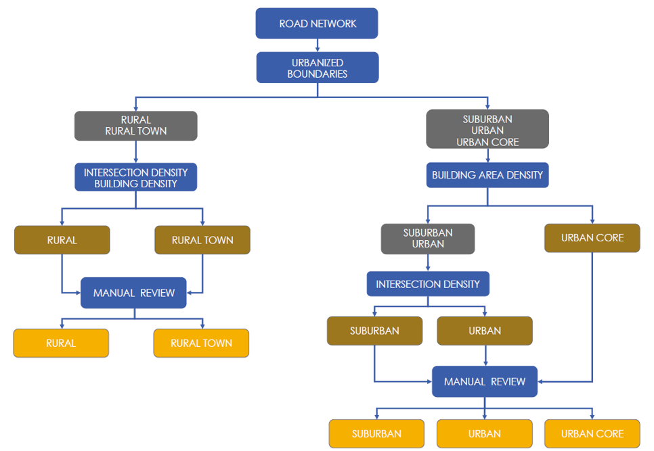
Automated Context Classification Approach
Source: NCHRP Report 1022, Stamatiadis et al. (2022)

Slide 6
Model Creation
Data | Source
FS Roads Layer | KYTC
2020 Adjusted Urban Area Boundary | FHWA
Intersection Nodes | KTC
US Buildings | Microsoft Bing Maps
Using the data above, a model was created in ArcGIS ModelBuilder to replicate the methods in NCHRP Report 1022
Context classification focused on state-maintained roadways and locally maintained arterials and collectors
Roads were segmented based on NCHRP methods; intersection, building, and building area density calculations were performed for buffer polygons associated with each road segment
Context was assigned based on intersection, building, and/or building area density values

Slide 7
Manual review
KTC met with all District Planners and provided the following resources to support their review:
A description of the context classifications and a “Tips” sheet to guide the review
A link to the interactive map displaying the draft network and supporting data layers
A spreadsheet for submitting proposed modifications to network segments
After reviewers submitted their proposed modifications, KTC updated the network and held follow-up meetings with each reviewer to confirm that the edits were implemented correctly and to address any remaining questions or issues.

Slide 8
Maintaining the Context Classification Network
KYTC’s Division of Planning will oversee the updates to the network.
Ongoing coordination with local planning partners will be needed to identify land use changes and update roadway context classifications to reflect evolving conditions within the transportation network.
The network should be updated to reflect changes in functional classifications made following adjustments to UABs based on new census data.
Notes:
Updates may include:
Reviewing segments whose functional classifications change from rural to urban to determine their appropriate context classification. This can be done manually (by identifying segments affected by functional classification updates and assigning a new context) or through an automated GIS-based process that generates updated context classifications. All updates should be manually reviewed by District planning staff.
Reviewing new or extended segments when they are added to the functional classification system to determine their context classification.
• Adjusting context classifications based on land use changes identified by District planning staff. Staff can submit a request to revise the context classification (with justification) to KYTC’s Division of Planning, Transportation Systems Branch.

Slide 9


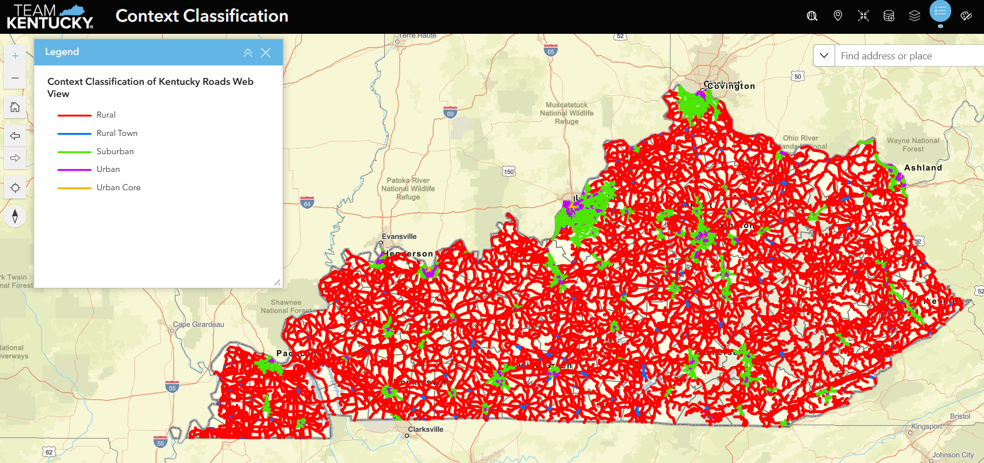
Kytc Maps –
Context classification
Notes:
A GIS layer is also available through KYTC Division of Planning’s HIS page.

Slide 10
Development of a KYTC Highway Geometric Design Workshop
“Roadway Geometry Fundamentals”
SPR 25-672

Slide 11


Why is geometric design training needed?
Geometric design is a core competency
A firm understanding of geometric design is needed to
  Create safe, efficient, and sustainable roadways
  Tackle complex geometric challenges
  Skillfully apply the latest design guidance
Notes:
Geometric design is a fundamental discipline at the Kentucky Transportation Cabinet (KYTC), playing a vital role in projects of all sizes—from major roadway reconstructions to minor improvements. Whether it's a brand-new alignment or a simple restriping effort, geometric considerations are always part of the equation. Even projects that don’t involve earthwork or wider pavement rely on geometric principles to guide layout decisions.
Effective roadway geometry influences traffic flow, travel speeds, and—most importantly—the safety of the traveling public. As opportunities for building on undisturbed ground become increasingly rare, today’s projects often involve complex geometric challenges on existing infrastructure. With design standards and guidance continually evolving, this training offers a valuable opportunity for both emerging and experienced designers to explore updated approaches and refine their skills.

Slide 12

Training Objectives
Build a foundation in geometric design principles
Explore the link between roadway geometry and safety
Encourage flexibility in design
Apply principles to real-world scenarios
Understand Kentucky's standard practices
Notes:
After determining WHY the training was needed we determined WHAT the main objectives of the training should be:
Build a Foundation in Geometric Design Principles
Gain a solid understanding of key geometric design elements—what they are, how they function, and how to appropriately select them during the design process.
Explore the Link Between Roadway Geometry and Safety
Learn how geometric features directly impact roadway safety and operational performance, and how thoughtful design can enhance safety outcomes.
Encourage Flexibility in Design
Understand when and how to apply engineering judgment in selecting design criteria for different roadway contexts and functions. Learn when it’s appropriate to pursue design exceptions or variances to meet project needs.
Apply Principles to Real-World Scenarios
Engage with practical examples throughout the training that demonstrate how geometric design principles are used to address common roadway challenges.
Understand Kentucky’s Standard Practices
Become familiar with commonly used geometric design practices in Kentucky, including those outlined in the KYTC Highway Design Manual.

Slide 13

Project Timeline
Study Kick-off
Training Curriculum & Materials Developed
Pilot Training Held
Training Revised
Final Report & Training Material
Three Regional Trainings Held
July 2024
September 2025
October 2025
Spring
2026
June 2026
Through 2026
Notes:
The project has moved out of the development stage and is now in the implementation stage with three course offerings in 2026.

Slide 14

Training Topic Module Structure
Geometric Design Introduction | Combined Horizontal & Vertical Algmt.
Highway Design Philosophy* | Roadway Cross Sections*
Geometric Design Resources | Roadside Safety
General Design Considerations* | Designing for Speed Management
Roadway Classifications | 2 + 1 Roadways
Human Factors in Road Design | At-Grade Intersection Overview
Vehicle Speeds* | Intersection Geometry*
Sight Distance | Evaluation of Geometric Design
Horizontal Alignment* | Contract Documents
Vertical Alignment | Case Studies
*Module with group class exercise
Notes:
Following the establishment of the training’s primary objectives—guided by the Study Advisory Committee—the team identified key subject areas to be included. The table on this slide outlines the current list of training modules. The training curriculum is organized into three sections.
The first part of the topics set the stage for geometric design. These are the knowledge areas and information needed to made geometric design decisions.
The second part of the topics contain the core geometric design concepts that form the backbone of geometric design expertise – Sight Distance, Horizontal Alignment, Vertical Alignment, Combined Horizontal and Vertical Alignment, and Cross sections.
The third part of the topics cover a range of more specialized topics to deepen understanding and broaden design capabilities.
With a key objective being to explore the link between geometric design and safety the team elected to weave in safety into the training topic modules rather than having a specific geometric design safety module. This helps reinforce the safety mindset throughout the training.

Slide 15

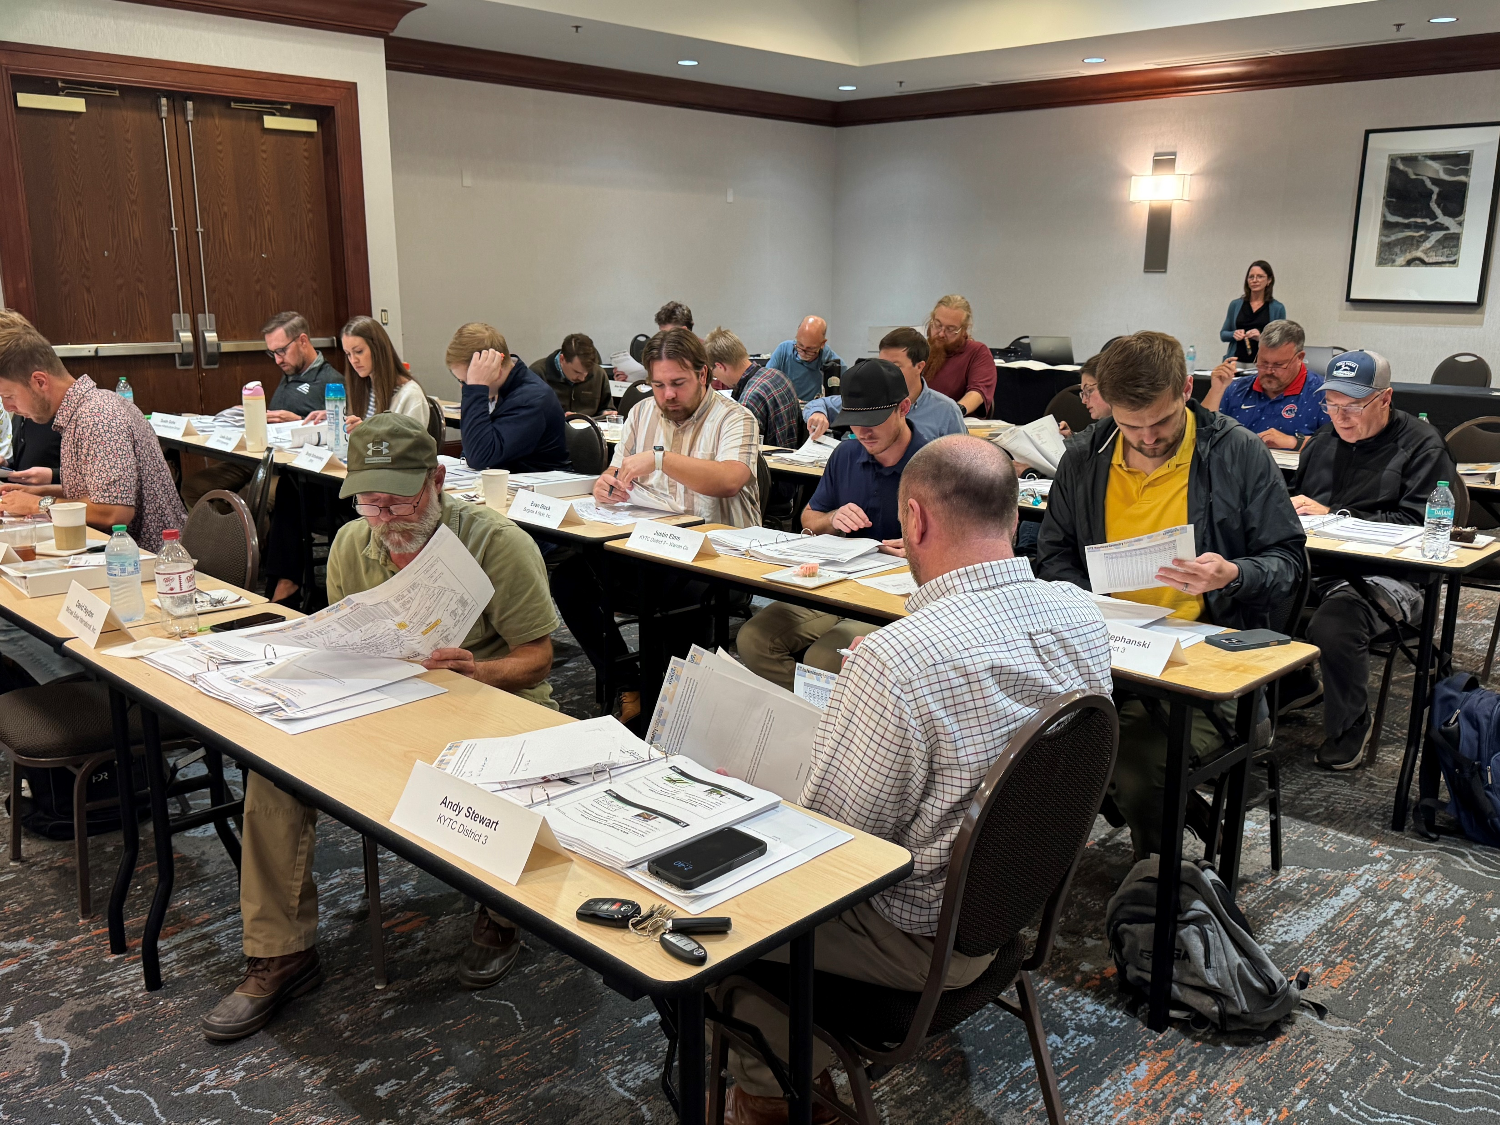
Training Summary
Twenty modules spread over five days
Five training days spread over two weeks
Collaboratively taught by KYTC and KTC staff

Slide 16

Training Participation
120 participants over four trainings
35% KYTC District Office Staff
17% KYTC Central Office Staff
47% Consultants
1% Other
Fourteen class instructors
Notes:
Percentages and numbers are for the four classes conducted to date, including the Pilot.
The other is one FHWA class participant.

Slide 17
Training Feedback Received
I learned so much relevant information over this course, it was so wonderfully informative, and I picked up on so many design tips and tricks.
This material is great for young engineers.
I’m impressed with the quality and organization of this class.
It was excellent. Highly recommended.
Notes:
From comments received at pilot training.

Slide 18

Future Trainings and Next Steps
Plan future training offerings.
Update curriculum to reflect the newest changes in national and state guidance and research findings.
Publish a Geometric Design Knowledge Book through the Highway Knowledge Portal
Notes:
Not sure how many trainings will be held in the future.
As future offerings of the class are scheduled, current guidance and research findings will be monitored and included in these trainings.
Ongoing is a publication of a Knowledge Book within the Highway Knowledge Portal based off of the developed training that will focus on Geometric Design topics.

Slide 19

Questions?
Notes:
From comments received at pilot training.

Slide 20

SPR 25-674
LPA Project Management Training

Slide 21
Study Advisory Committee
Name | Title
Jason Siwula | KYTC – Deputy State Highway Engineer
Brian Eaton (Chair) | KYTC – District 5 LPA Coordinator
Susan Oatman | KYTC – Statewide LPA Coordinator
Jackie Jones | KYTC - Department of Rural & Municipal Aid
Shane Tucker | KYTC – District 7 LPA Coordinator
Dane Blackburn | KYTC – District 6 LPA Coordinator
Rick Stansel | KYTC – Office of Local Programs
Camille Robinson | FHWA Liaison
Aaron Buckner | FHWA Liaison

Slide 22
Research Team
Name | Title
Bryan Gibson | KTC – Principal Investigator
David Moses | KTC – Co Principal Investigator
Travis Thompson | KTC – Research Engineer

Slide 23
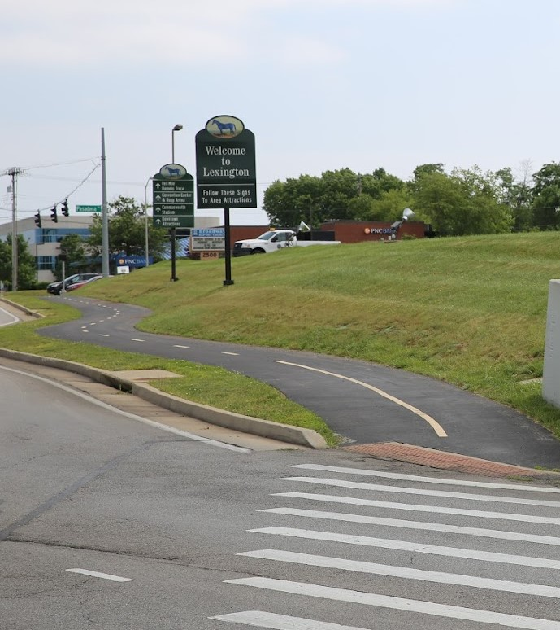
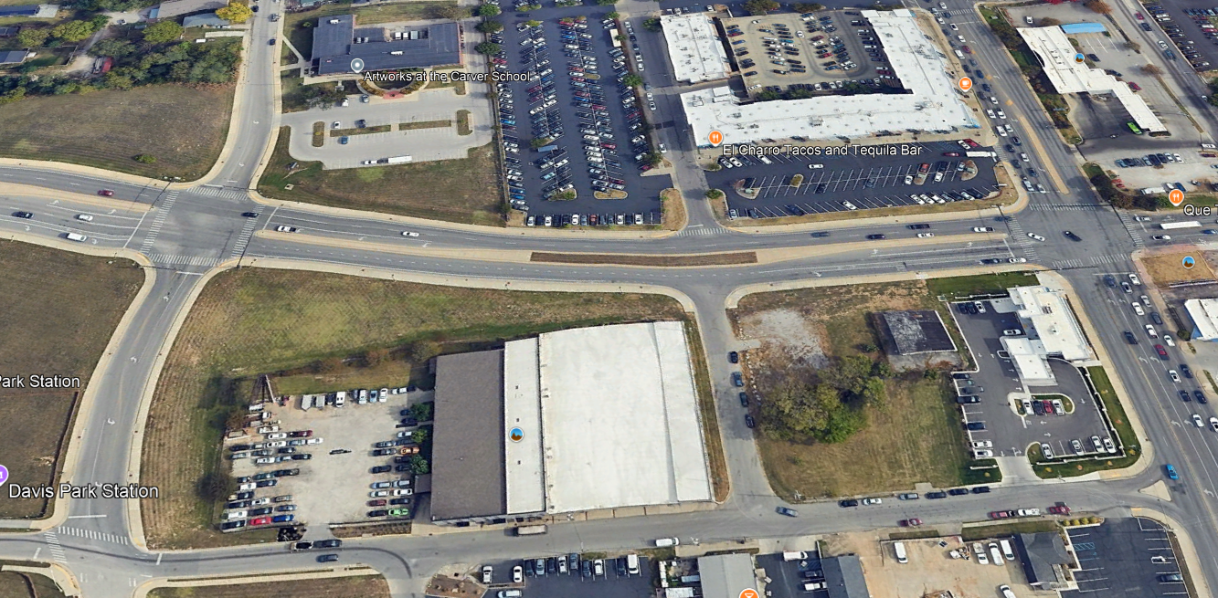
LPA Projects
LPA Projects vary in size from small sidewalk projects to large roadway projects like the Newtown Pike Extension

Slide 24
LPA Project Management
KYTC is responsible for oversight of LPA projects
The KYTC offices involved in the project will be a combination of a District Office and the Office of Local Programs within the Division of Rural and Municipal Aid
If the project is within the boundaries of a Metropolitan Planning Organization (MPO), the MPO will be involved as well

Slide 25
Class Development
Two classes are being developed
LPA 101 – Brief, high level, half day training.
  Target audience: mayors, county Judges and other elected officials
LPA 102 – In depth course, covering all disciplines.
  Target audience: project managers for the LPA, KYTC personnel involved in the projects, consultants

Slide 26
LPA Project Management Training
Class Modules
Introduction to LPA Projects
Overview of Project Development and Delivery
Professional Services Procurement
Environmental Requirements
Project Design
Right of Way
Utilities and Rails
Non-Construction Procurement
Construction Procurement
Construction and Inspection
Reimbursement
Project Completion

Slide 27


Slide 28
Questions?

Slide 29
Bridge Load Posting
Based on Load Testing
Study Advisory Committee
Dora Alexander (Chair)
Erin Van Zee
Evan Greenwell
Research Team
Cody Hutchinson
Abheetha Peiris (PI)
Issam Harik (Co-PI)

Slide 30
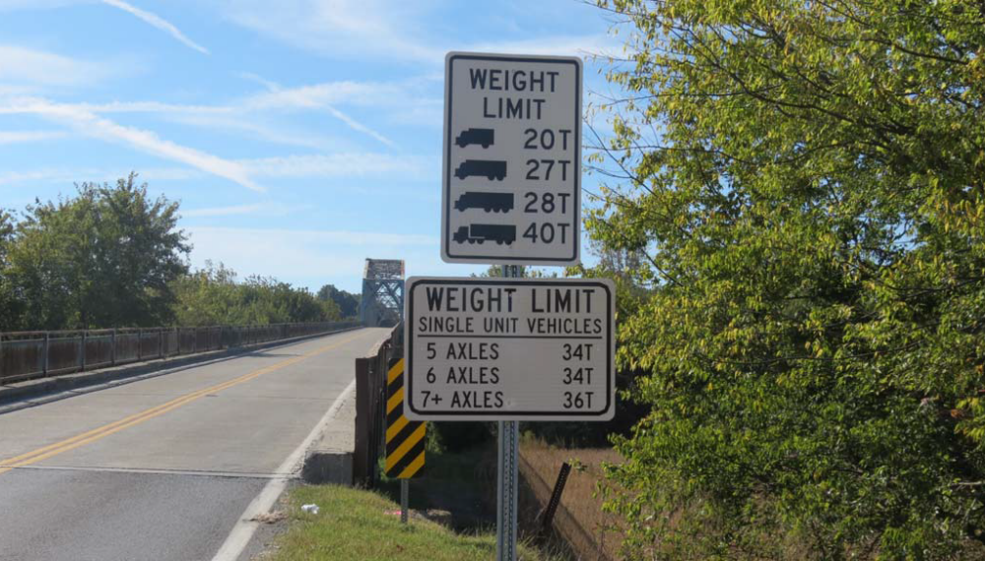
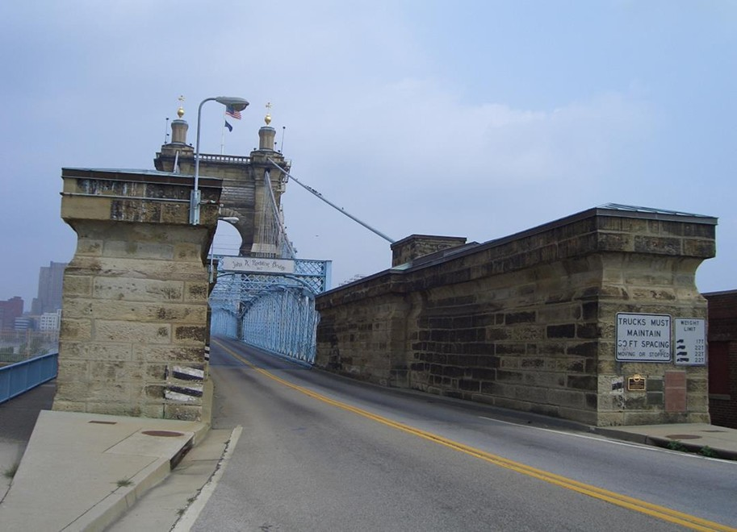
Load Posting
What is “load posting”?
US 60 Over Cumberland River (D01)
John A. Roebling Bridge (D06)

Slide 31
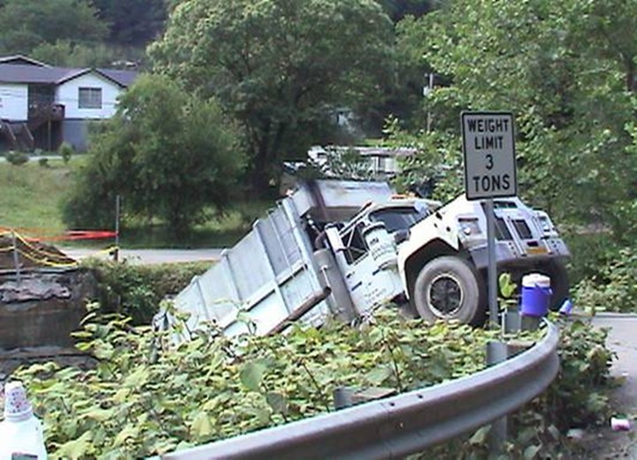
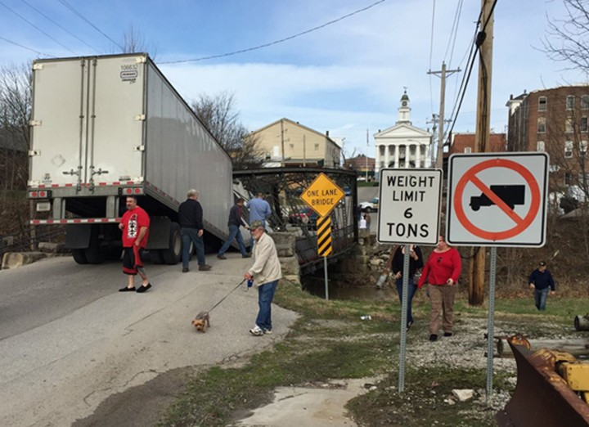
Load Posting
Why load post?
Pike County, Kentucky
Orange County, Indiana

Slide 32
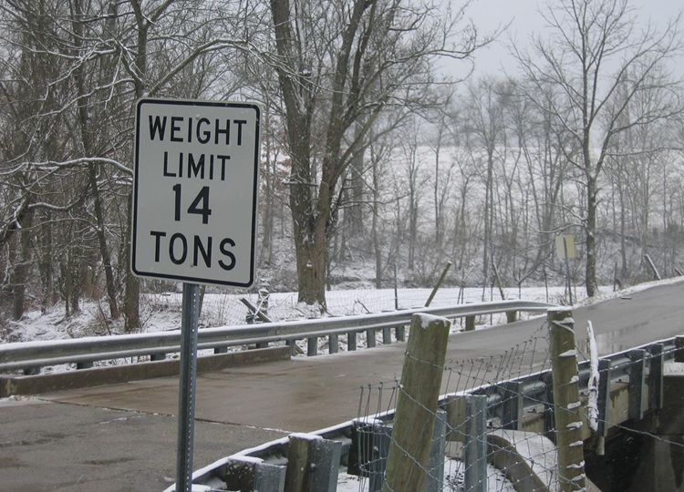
Load Posting
When to load post…
The bridge owner must restrict truck weights when load rating predicts a bridge cannot safely carry standard legal trucks
KY-32 over Lytles Creek (D07)

Slide 33
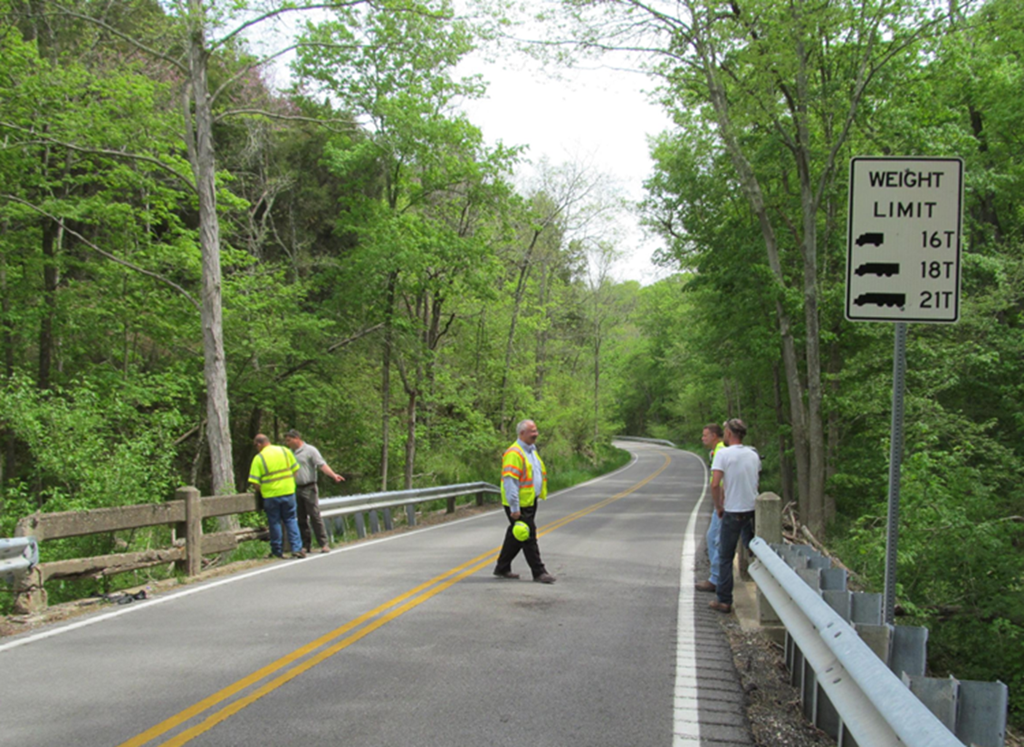
Load Rating
What is “load rating”?
Determination of the safe live load capacity of a bridge.
Often expressed as a Rating Factor (RF) or the gross tonnage for a given axle configuration.
KY-55 over Majors Creek (D06)

Slide 34


Rating Factor (RF)
$$RF=\frac{Capacity}{Demand}$$
Inventory Ratings
Maximum live load safe for travel over an indefinite period
Operating Ratings
Maximum live load safe for travel but which may shorten the life of the structure
RF < 1.0 → Load Posting Required
RF ≥ 1.0 → No Load Posting Required

Slide 35

Rating Factor (RF)
Geometric data
  Bridge layout: span, girder spacing, skew etc.
  Component dimensions: cross sections (beams, deck, column), reinforcement
Material properties
  Concrete compressive strength
  Steel yield and ultimate strength
Condition data from inspections
From design/construction plans
$$RF=\frac{Capacity}{Demand}$$
Dead Load is calculated
Live Load
  Federal legal trucks and load combinations
  State legal trucks
Prescribed by standards

Slide 36
Load Rating Through Load Testing
Load Rating Through Load Testing should be considered when:
Theoretical ratings are low
Structural plans are unavailable
Material properties are unknown
Uncertain load distribution
Heavily damaged/deteriorated members
Provides the most accurate ratings possible

Slide 37


Load Rating Through Load Testing
Theoretical Rating Factor
Field Test Adjusted RF:
$$RF_{T}=RF_{C}∙K$$
Field Test Adjustment Factor:
$$K=1+K_{a}∙K_{b}$$

Slide 38
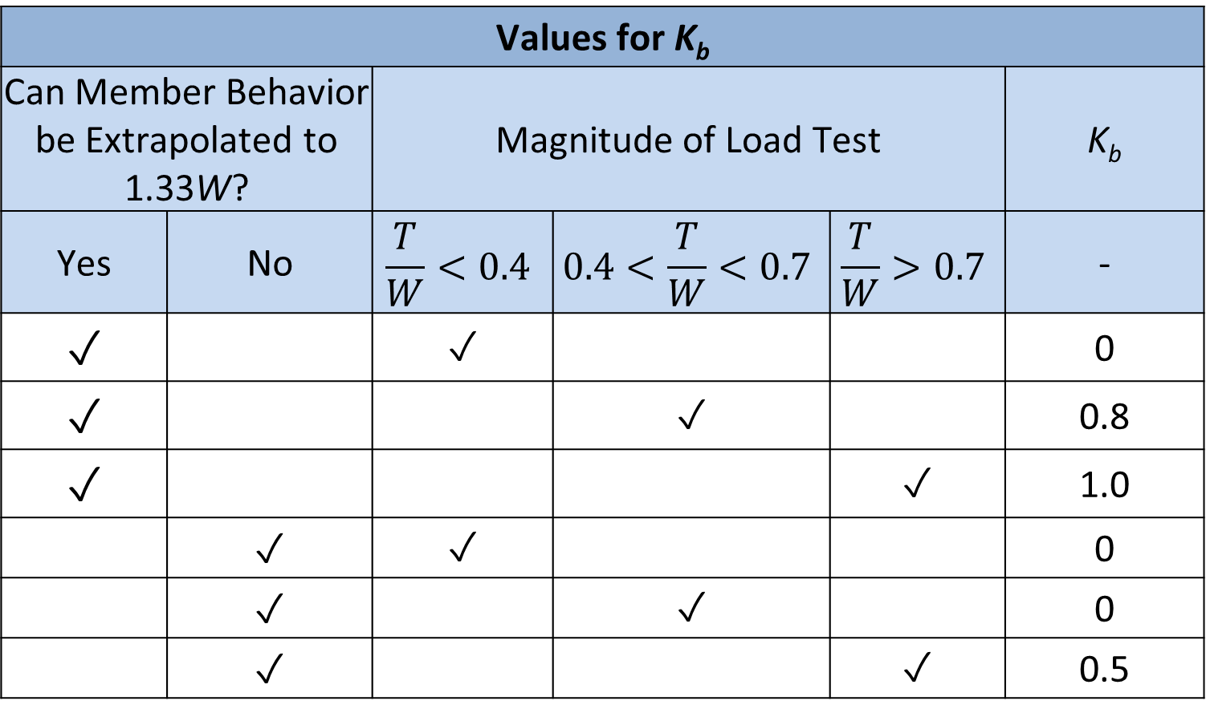
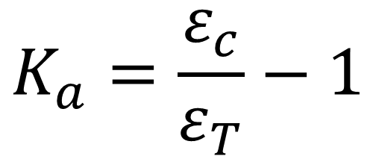

Load Rating Through Load Testing
Field Test Adjustment Factor:
$$K=1+K_{a}∙K_{b}$$
Values for K_{b}
Can Member Behavior be Extrapolated to 1.33W? |  | Magnitude of Load Test |  |  | K_{b}
Yes | No | $$\frac{T}{W}<0.4$$ | $$0.4<\frac{T}{W}<0.7$$ | $$\frac{T}{W}>0.7$$ | -
✓ |  | ✓ |  |  | 0
✓ |  |  | ✓ |  | 0.8
✓ |  |  |  | ✓ | 1.0
 | ✓ | ✓ |  |  | 0
 | ✓ |  | ✓ |  | 0
 | ✓ |  |  | ✓ | 0.5
Calculated Strain
$$K_{a}=\frac{ε_{c}}{ε_{T}}−1$$
Measured Strain

Slide 39
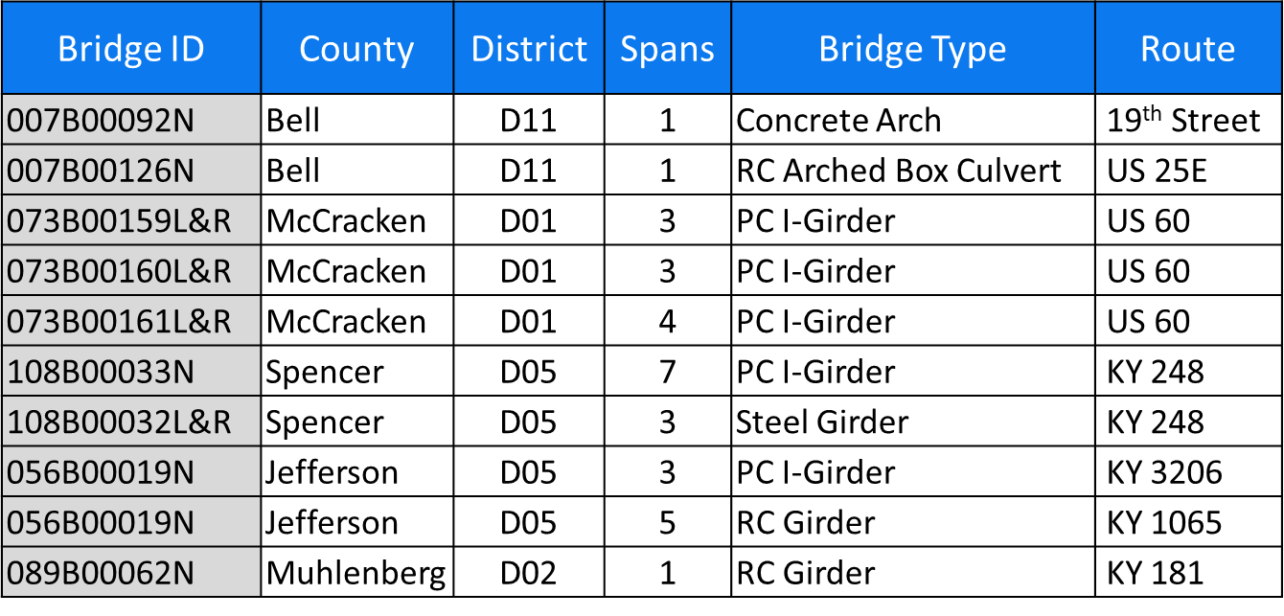
Load Testing Project

Slide 40
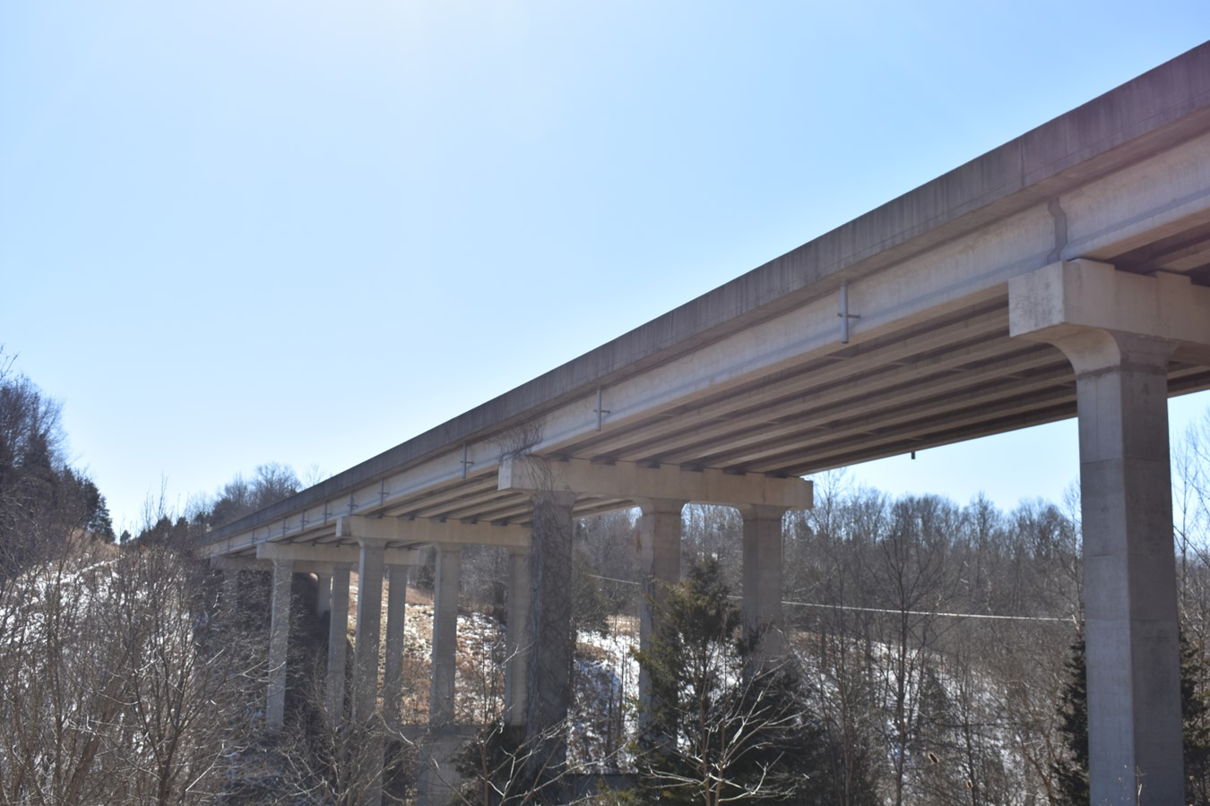

Case Study: Little Beech Creek Bridge
Constructed: 1981
Carries: KY-248
Crosses: Little Beech Creek
Traffic Lanes: 2
ADT: 2,298 cars/day

Slide 41
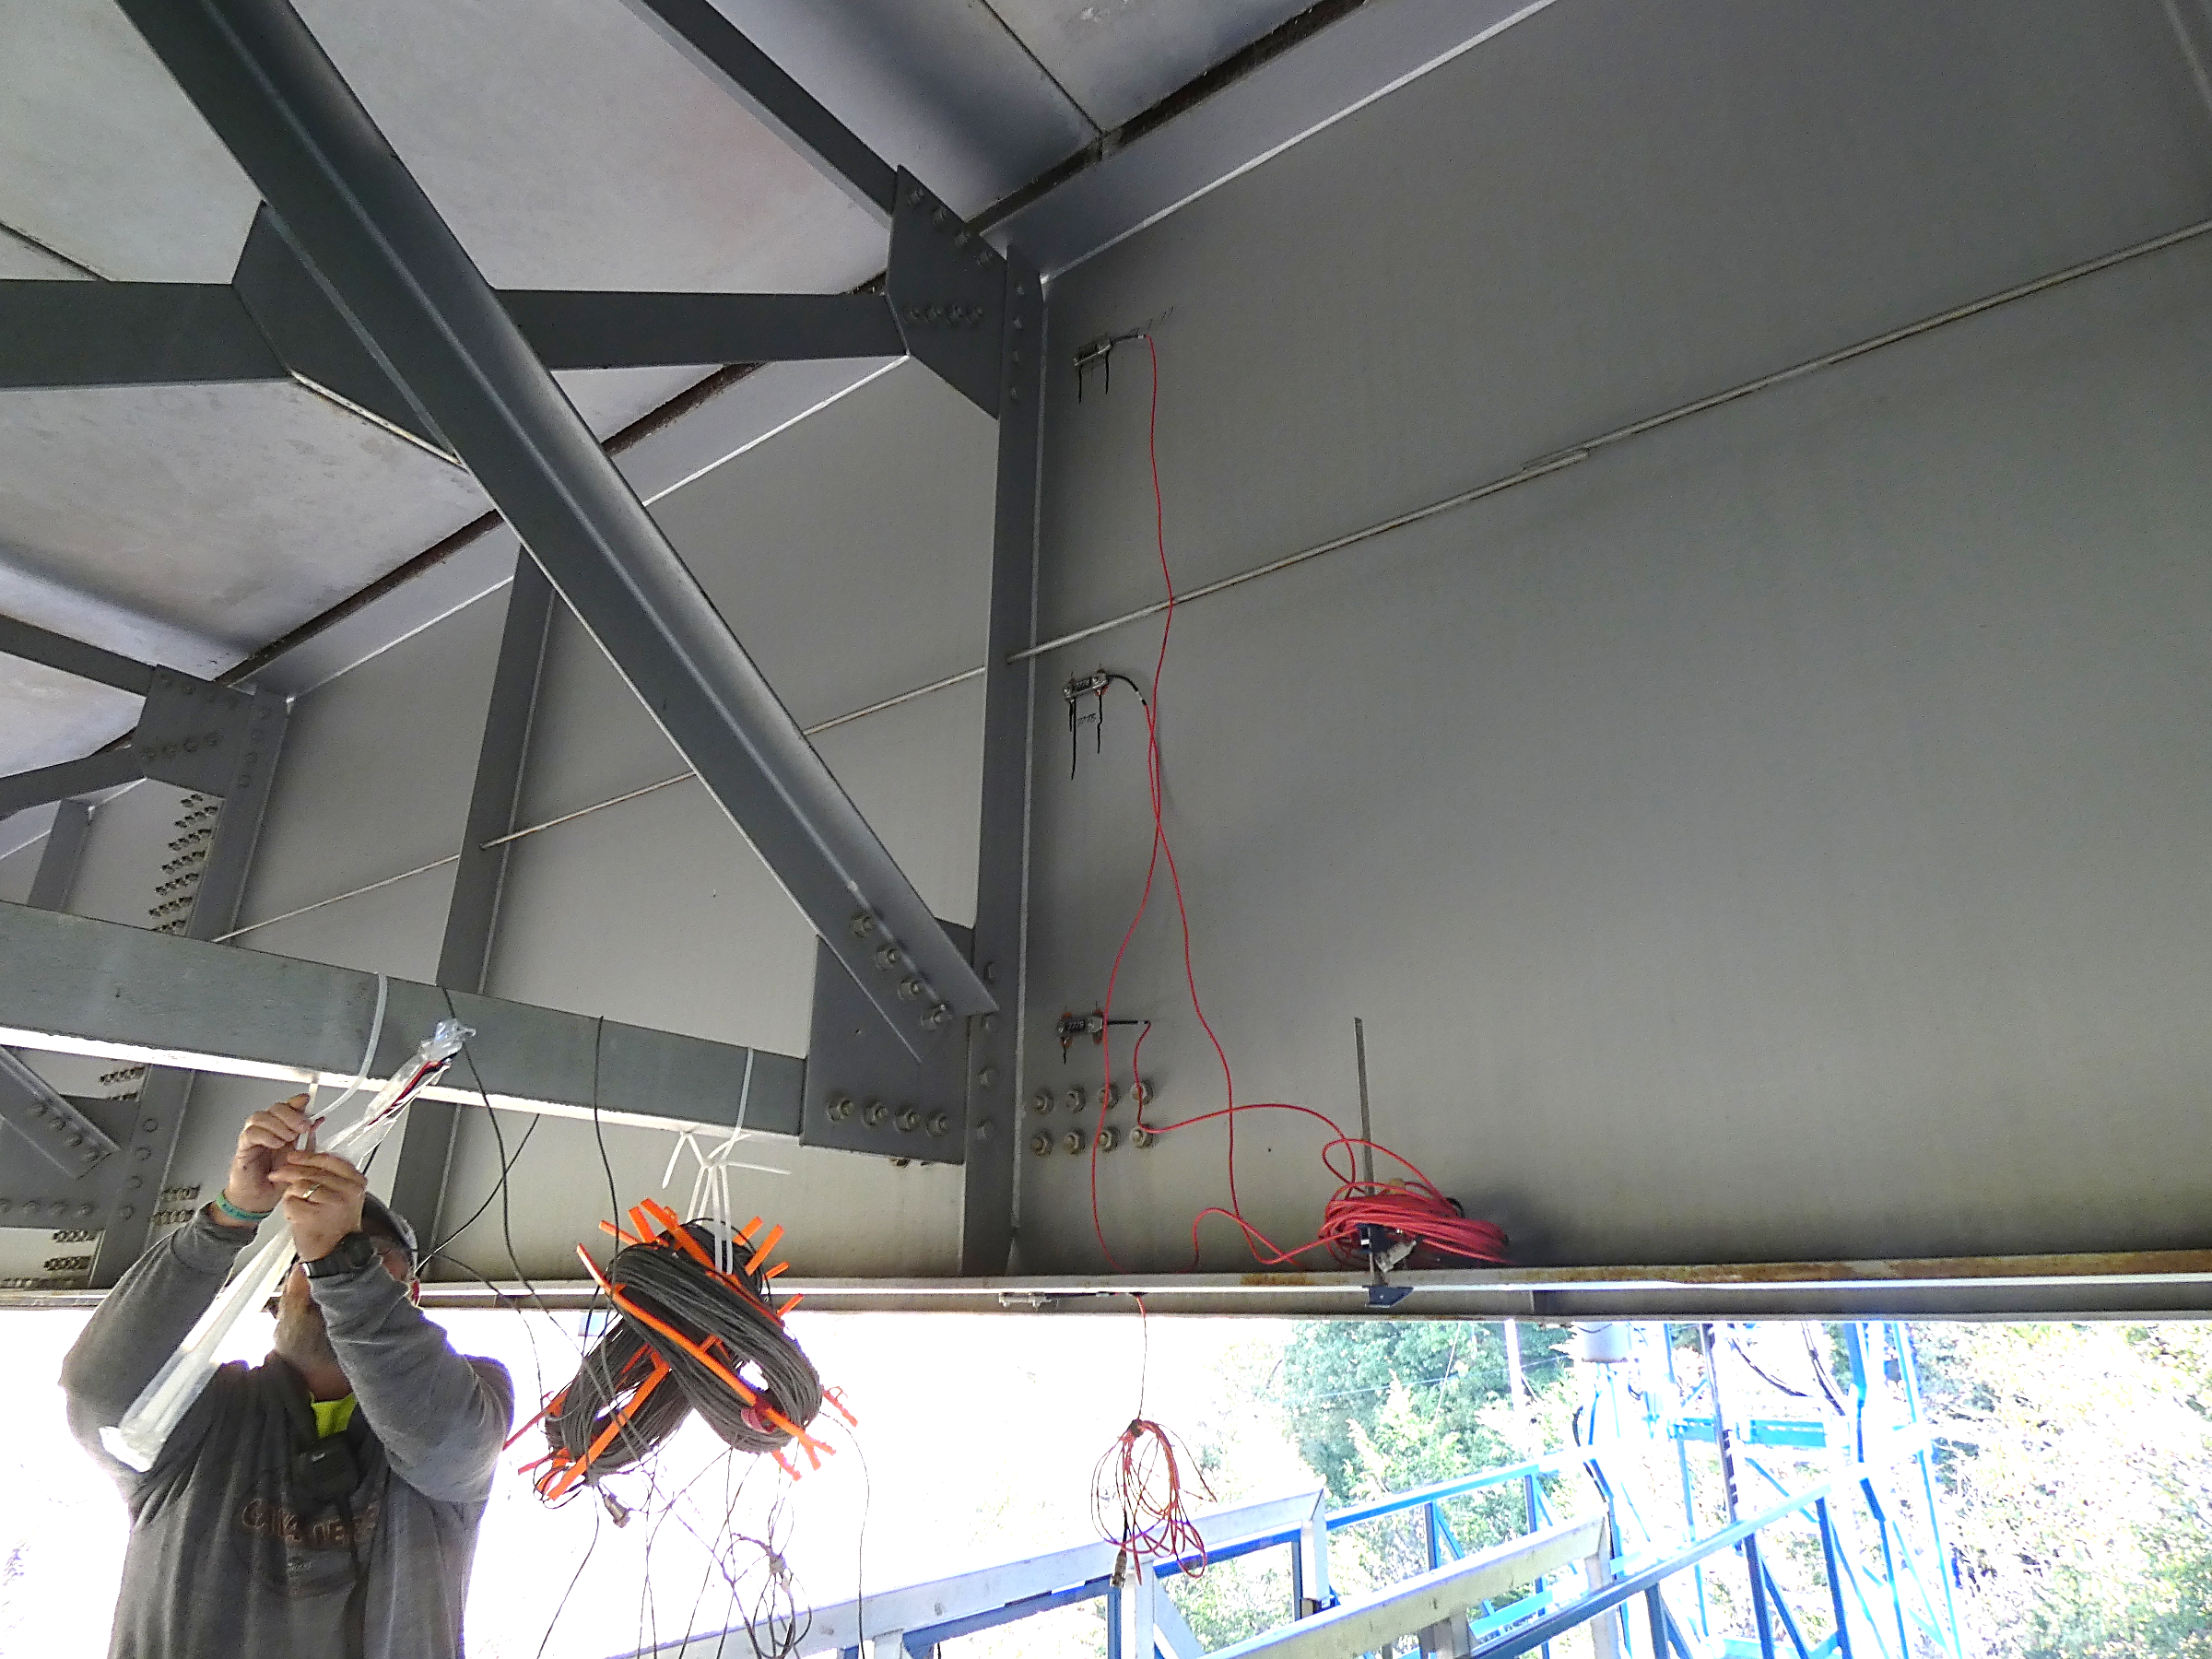


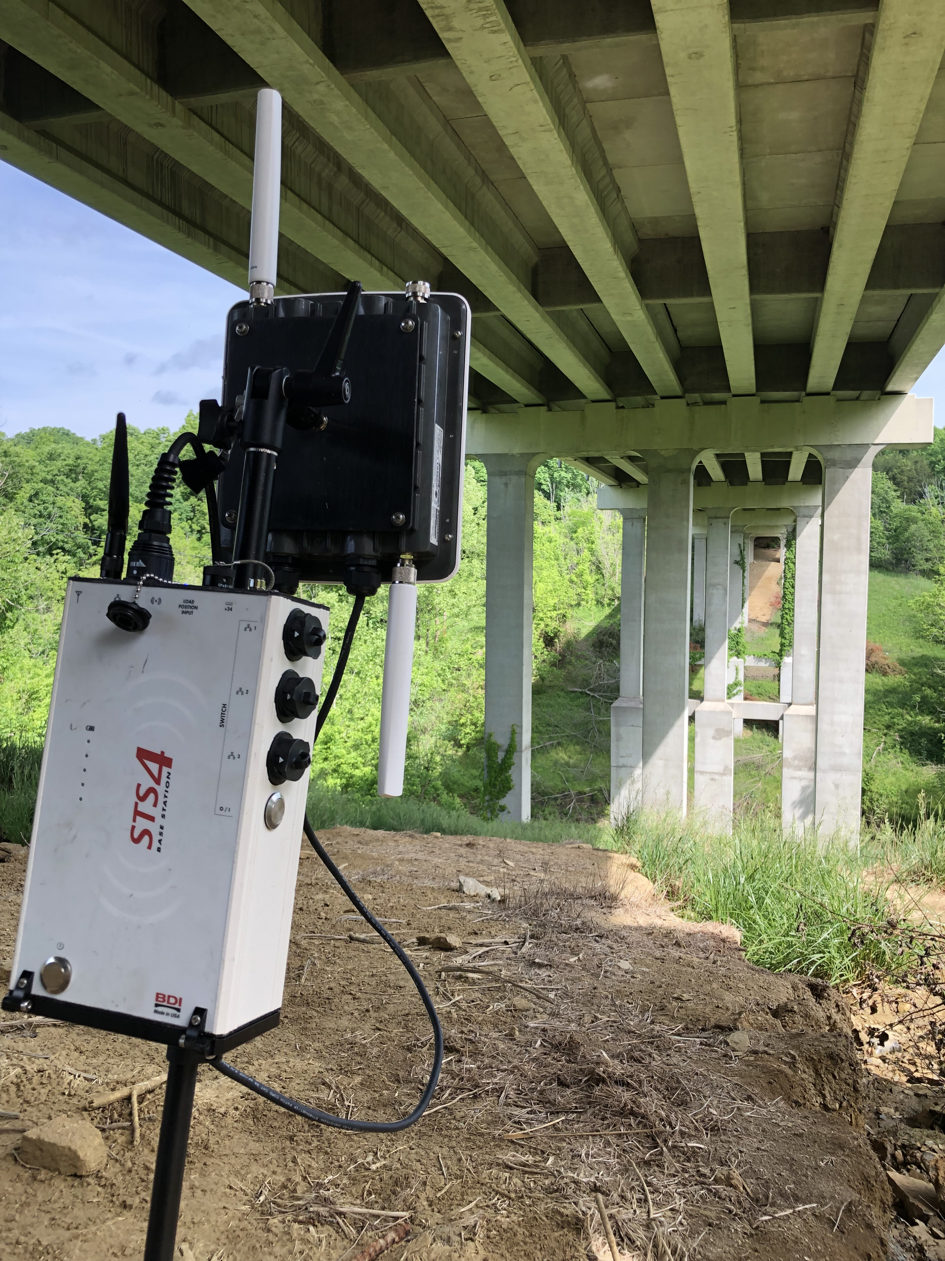
Instrumentation
STS Live Software
Nodes
Base Station

Slide 42
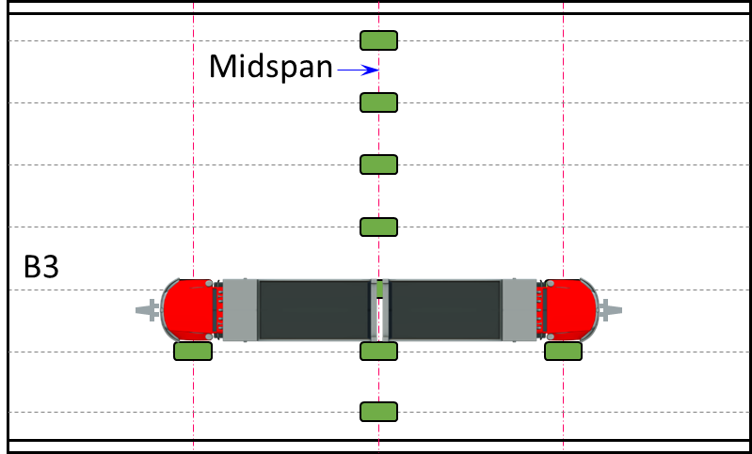
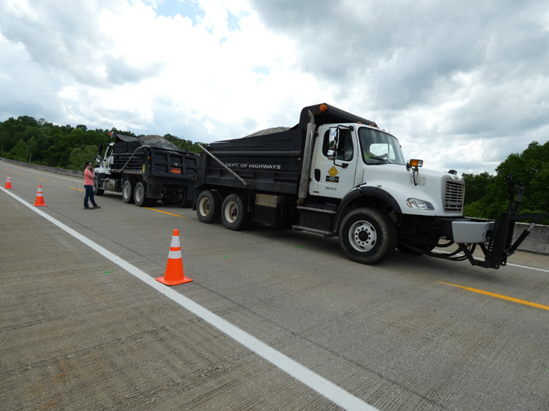
Load Testing
80 ft Span Controlling Load Case

Slide 43
Load Testing
80 ft Span Controlling Load Case

Slide 44
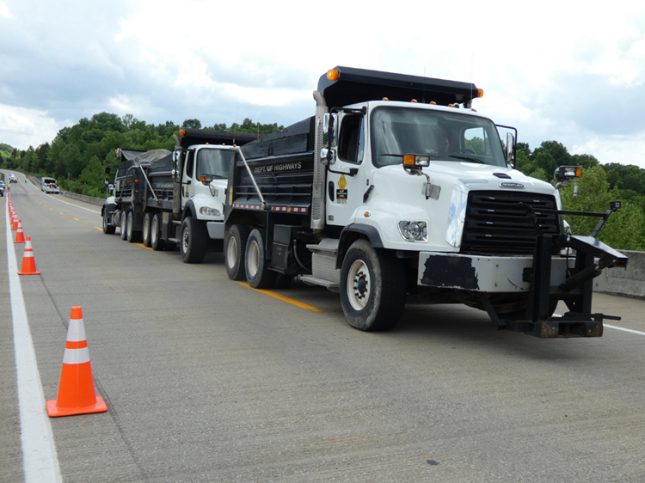
Load Testing
101 ft Span Controlling Load Case

Slide 45
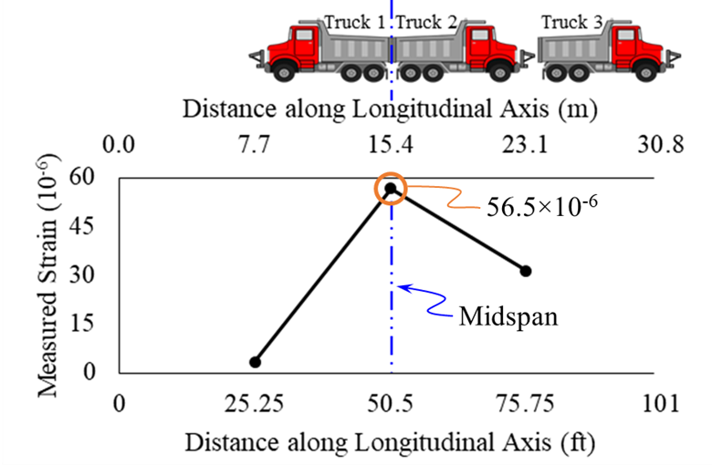
Load Testing
101 ft Span Controlling Load Case

Slide 46

Field Test Adjusted RFs
LRFR Theoretical RF
 |  | Field Test Adjusted LRFR Theoretical Rating Factors
Truck | Gross Weight | 80 ft Span |  | 101 ft Span
Truck | Gross Weight | Inventory | Operating | Inventory | Operating
HL-93 | Varies | 7.19 | 9.31 | 6.69 | 8.67
KY Type 1 | 20.00 tons | 14.83 | 19.20 | 14.48 | 18.74
KY Type 2 | 28.35 tons | 10.72 | 13.87 | 10.43 | 13.55
KY Type 3 | 36.75 tons | 8.73 | 11.30 | 8.49 | 11.00
KY Type 4 | 40.00 tons | 9.44 | 12.20 | 9.06 | 11.75
$$RF_{T}=RF_{C}∙K$$
80 ft Span
K = 6.42
101 ft Span
K = 4.40

Slide 47
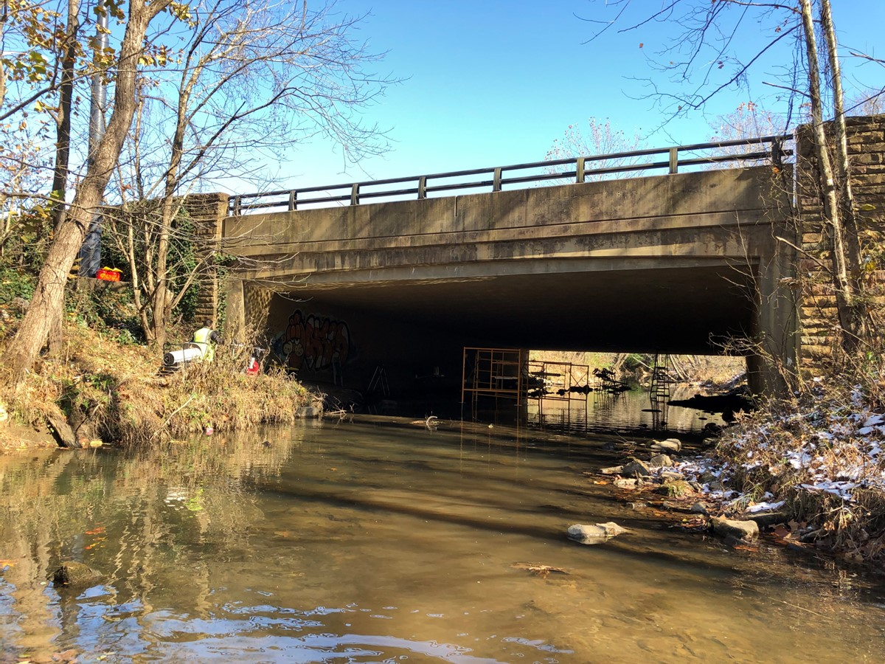
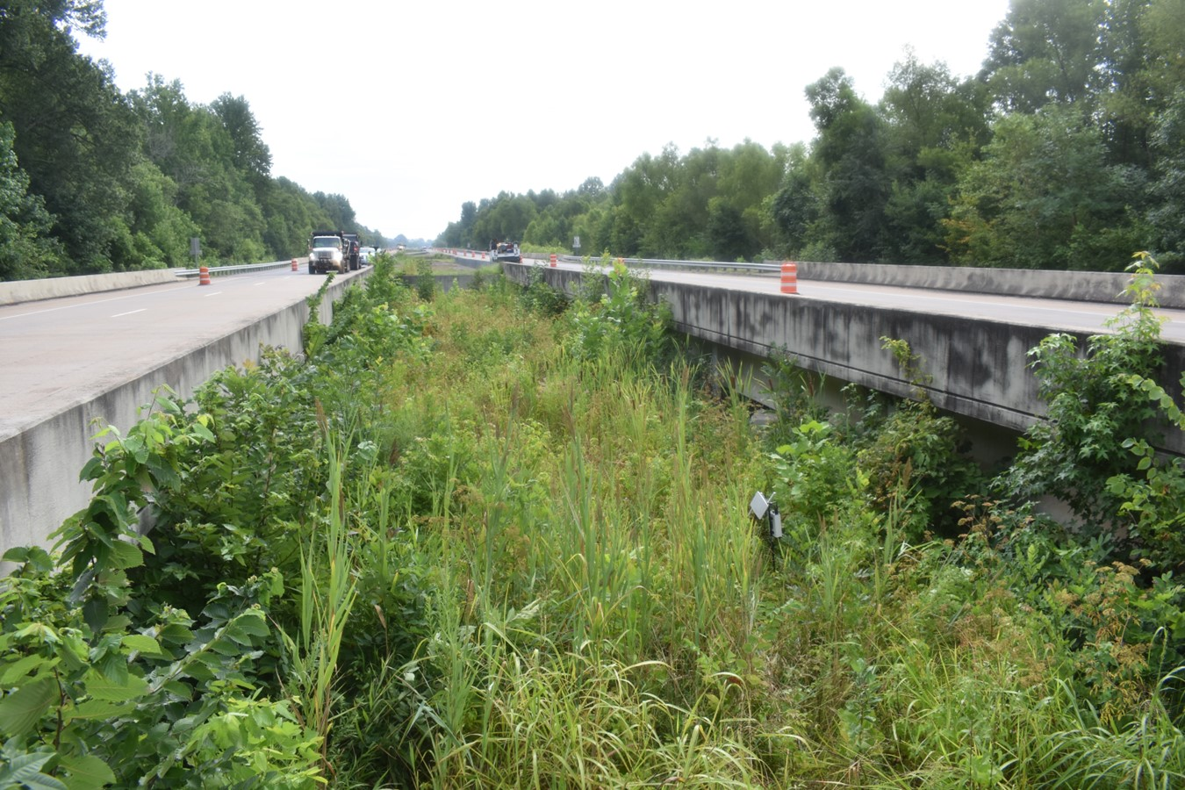
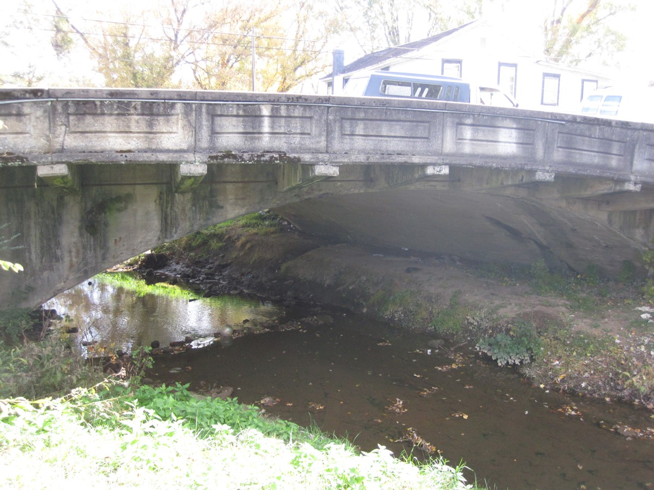
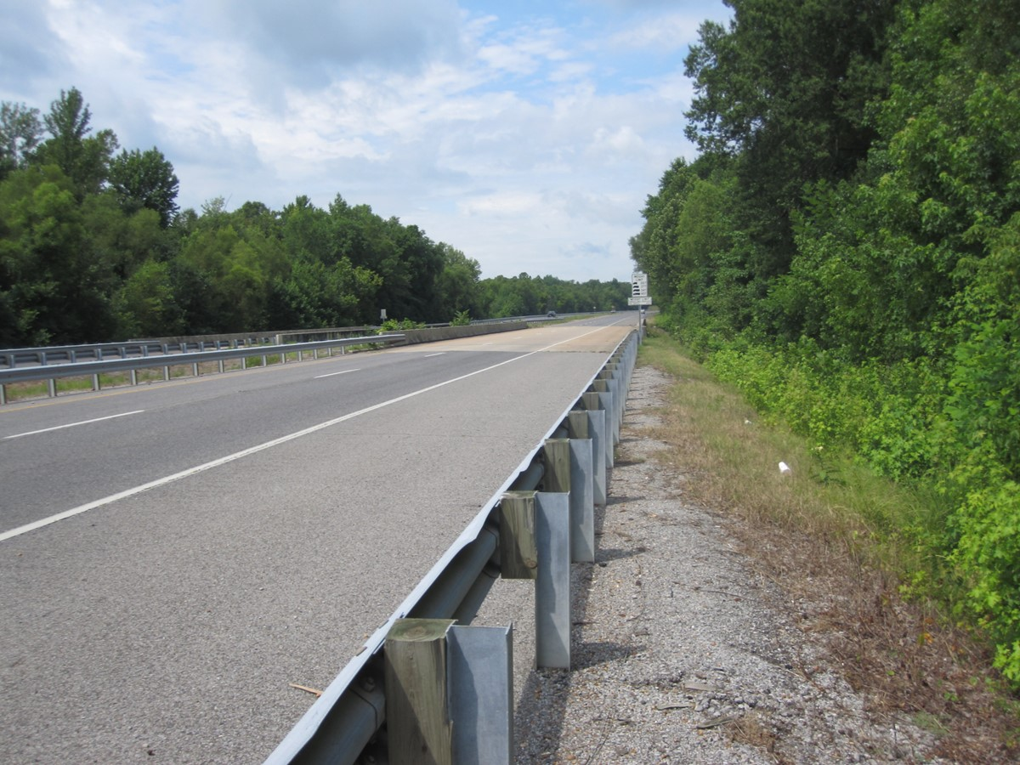
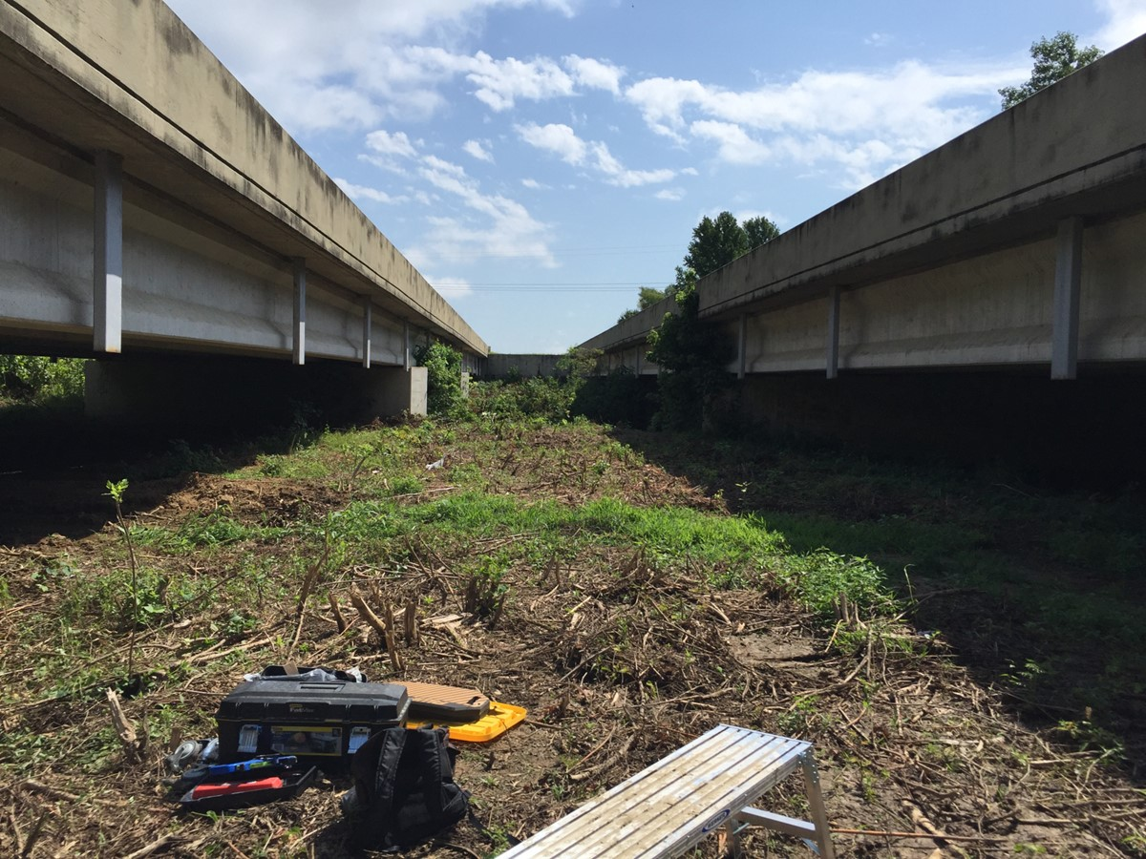
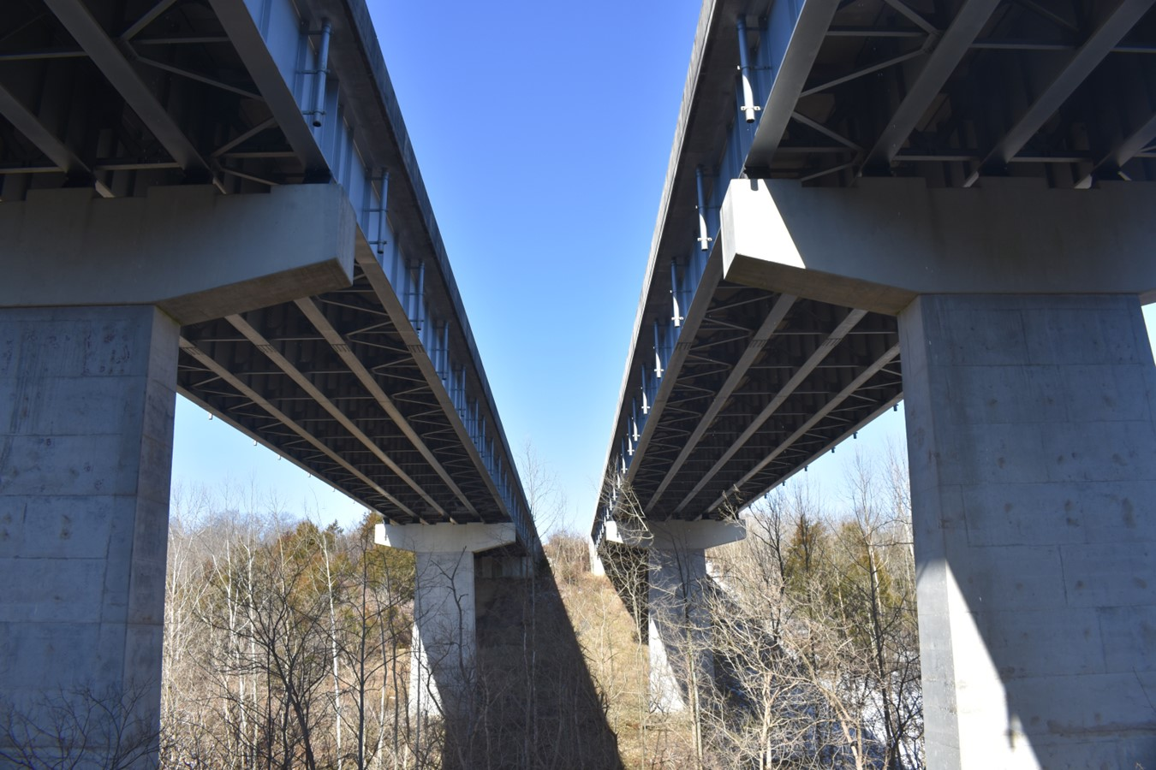
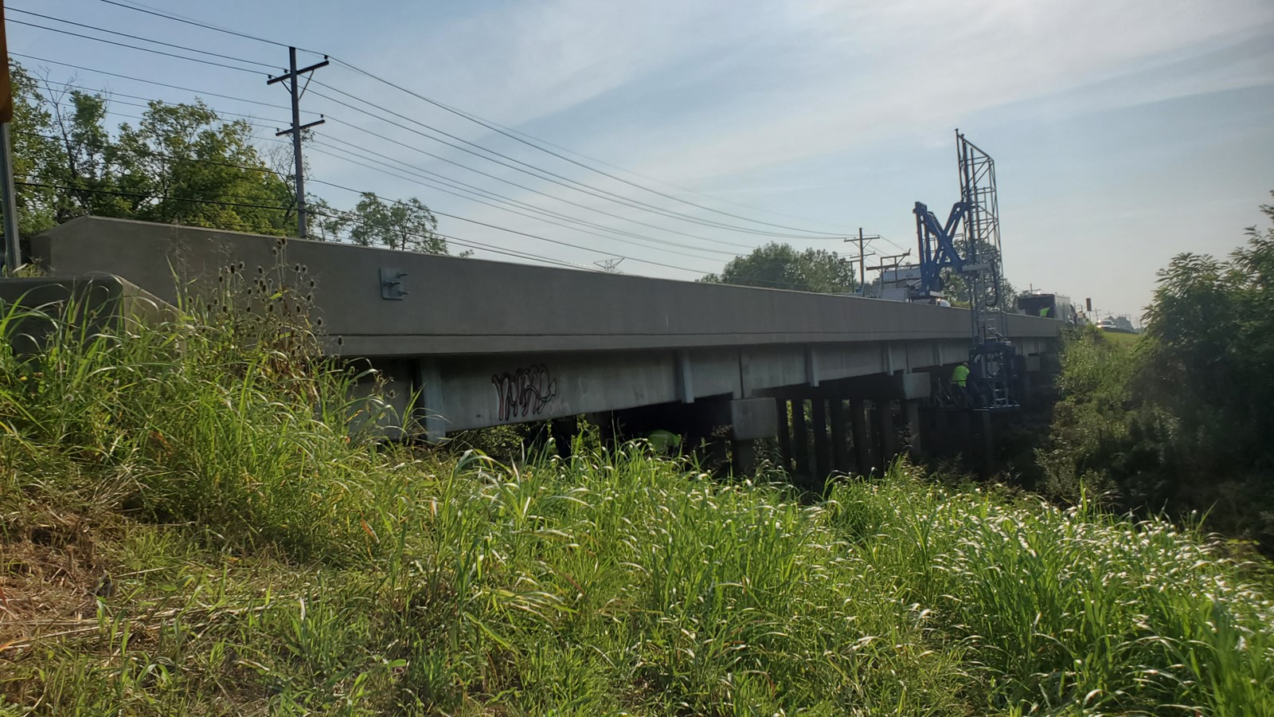
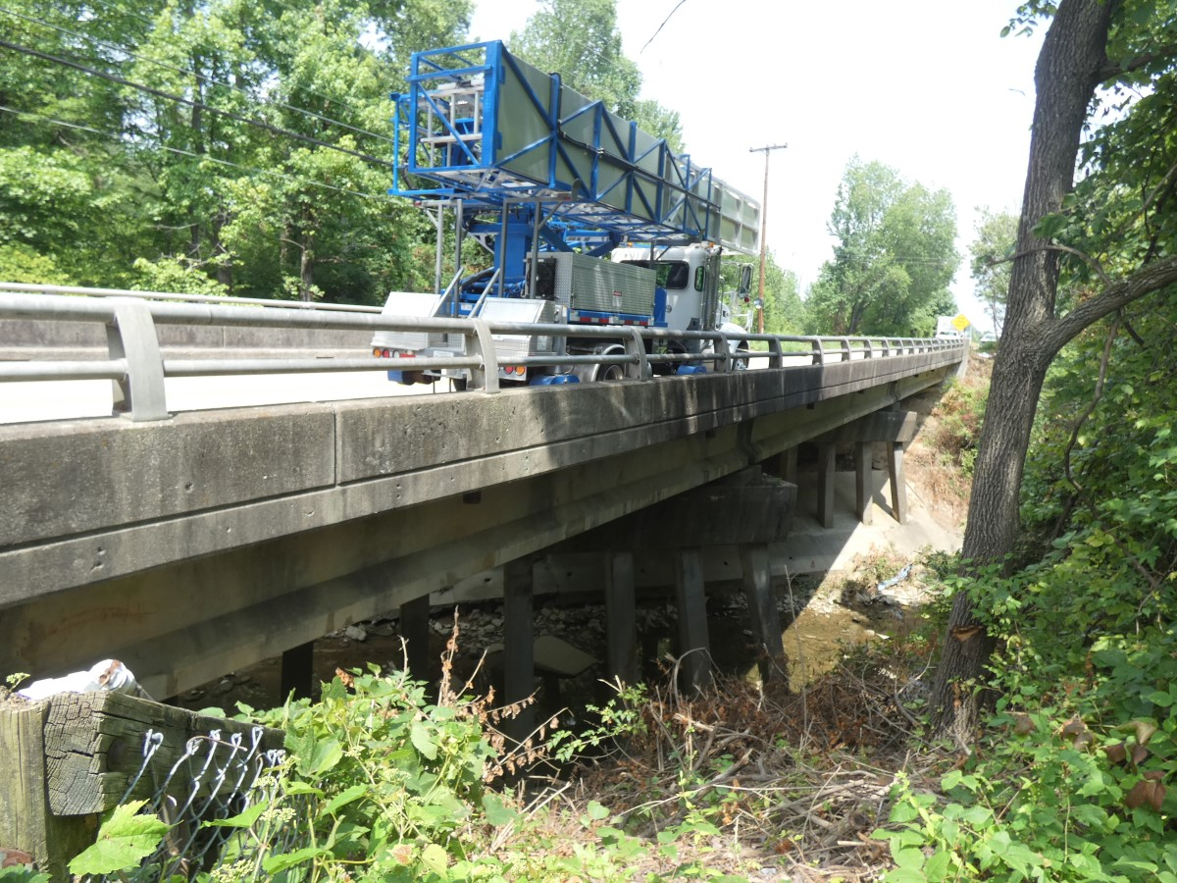
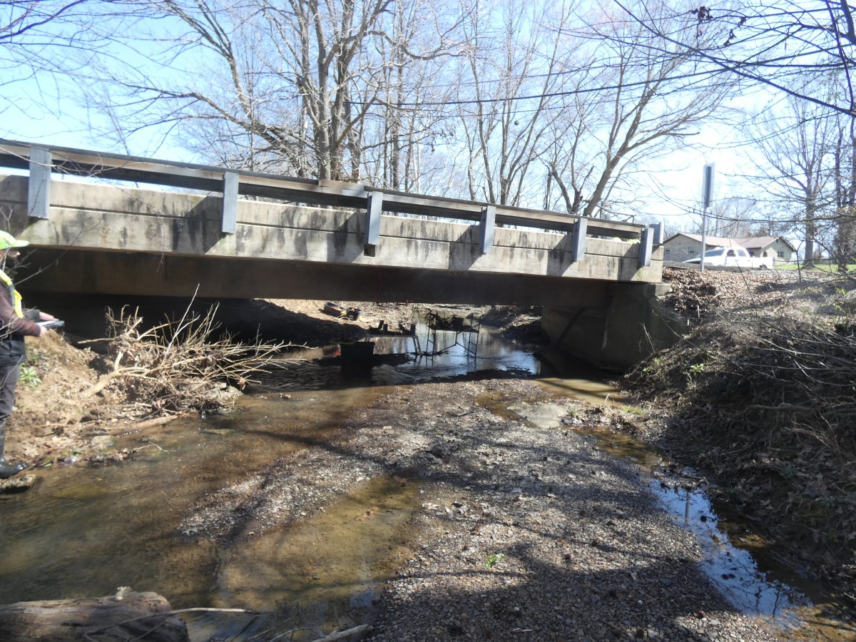
No bridges had detailed structural plans available.
20-40
20-40
Bridges were generally posted for:
22 tons (gross)
20 – 40 tons (by axle)
007B00092N
007B00126N
073B00159L&R
20-40
20-40
Load Testing eliminated the need for load posting!
073B00160L&R
073B00161L&R
108B00033N
20-40
?
20-31
108B00032L&R
056B00019N
056B00094N
089B00062N

Slide 48

Questions?
Bridge Load Posting Based on Load Testing

